Slide 1
Fly Fishing
Matthew Glowfeskie

Slide 2
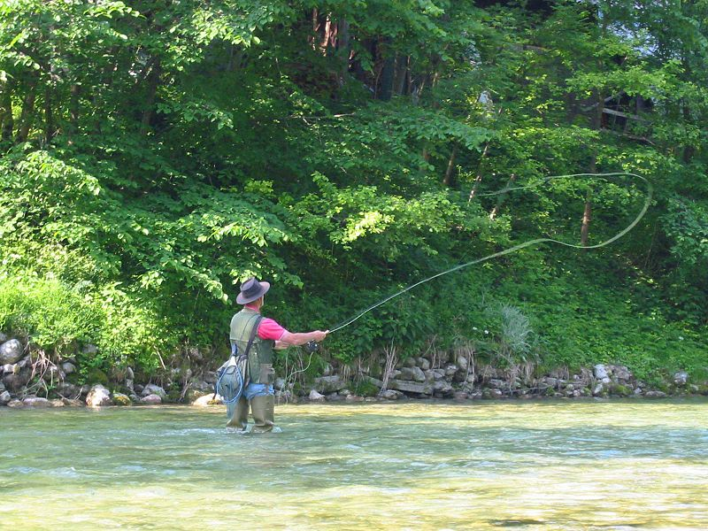
What is Fly Fishing?
-Fly fishing is an angling method in which an artificial "fly" is
used to catch fish.

Slide 3
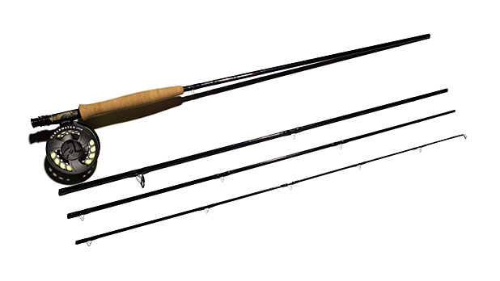
Equipment for Fly Fishing
-Specialized Fly-Rod and Reel

Slide 4
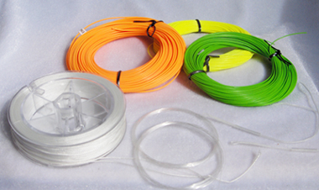
Equipment Continued…
-Specialized Fly-Line
-Leader for Fly-Line

Slide 5
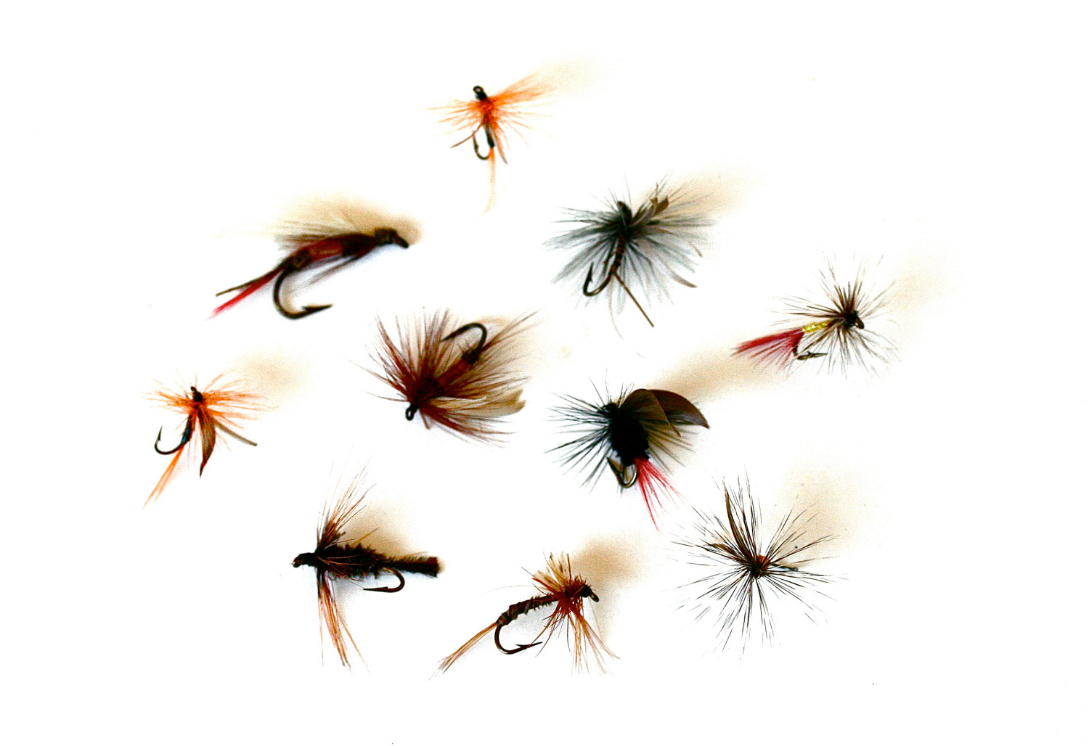
Equipment Continued…
-Flies

Slide 6
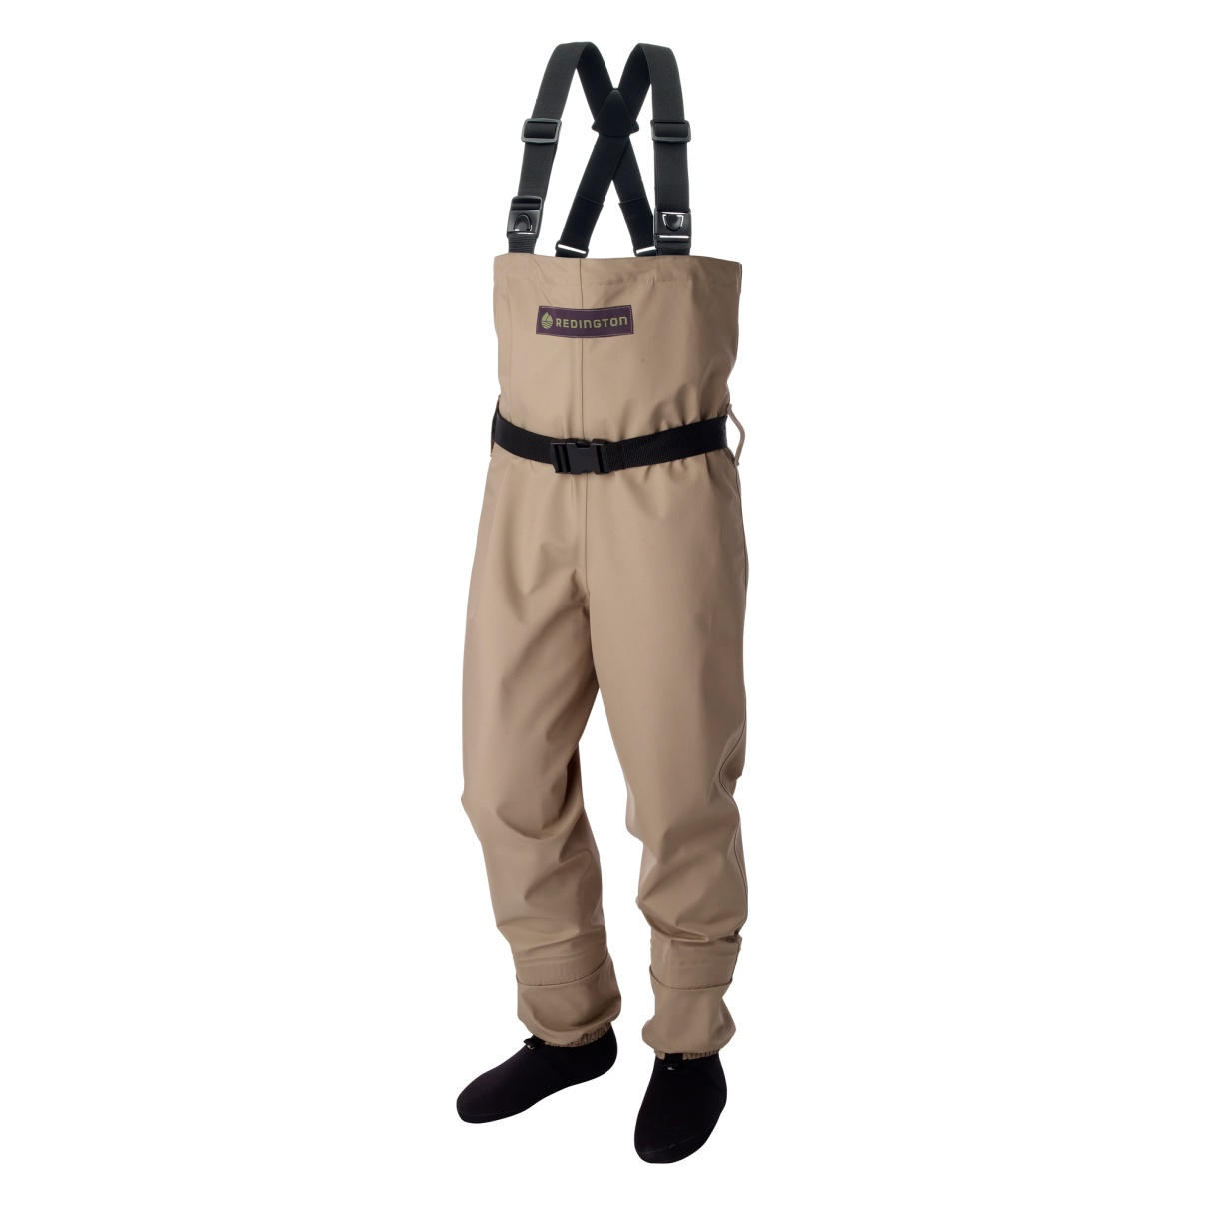
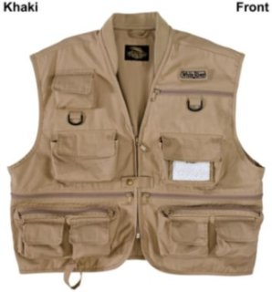
Equipment Continued…
-Fishing Vest
-Waders

Slide 7
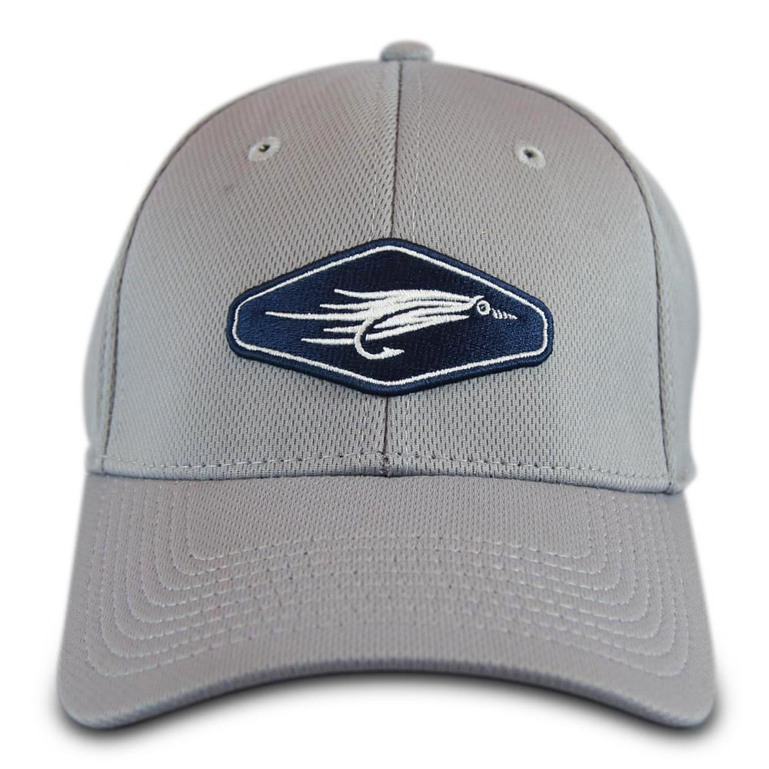
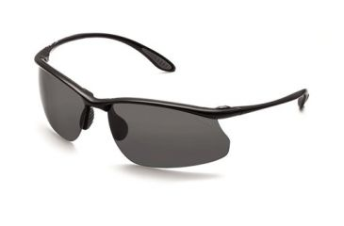
Equipment Continued
-Fishing Hat
-Polarized Glasses

Slide 8
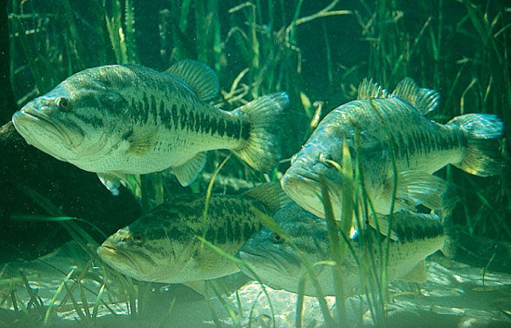
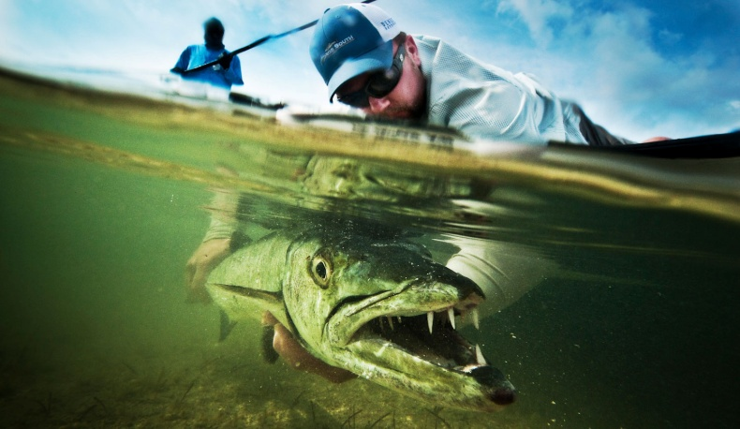
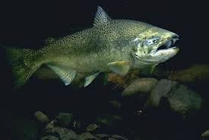
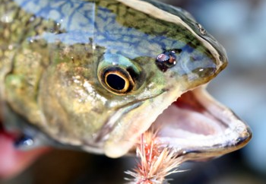
What can you Fly Fish for?
-All kinds of fish!
-Bass
-Trout
-Salmon
-Crappie
-Pike
-Barracuda
-Shark
Largemouth Bass
Barracuda
King Salmon
Trout

Slide 9
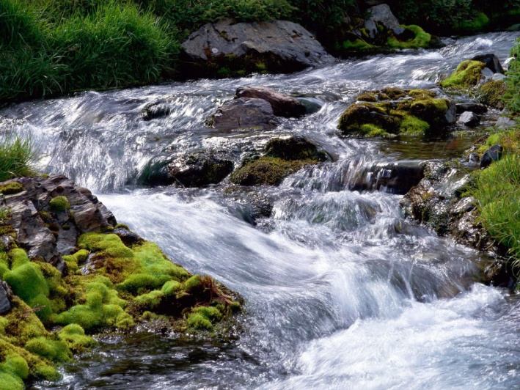
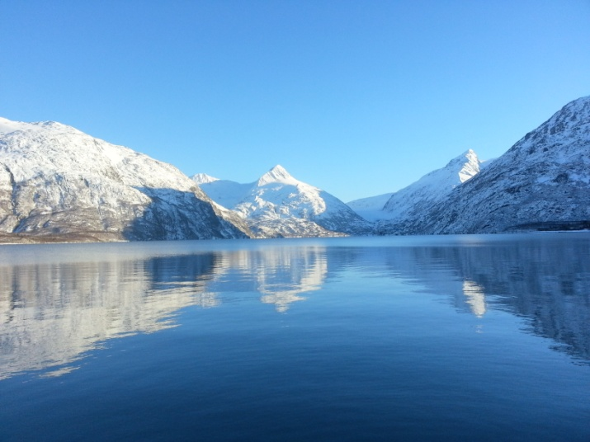
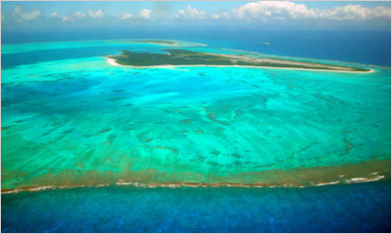
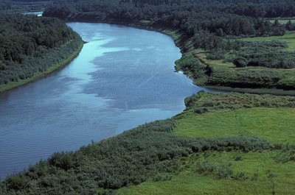
Where do you go Fly Fishing?
-Any source of water with fish
-Creeks
-Streams
-Rivers
-Ponds
-Lakes
-Seas
-Oceans
Stream
Lake
Ocean
River

Slide 10
Local areas to go Fly Fishing
-Sandy Creek-
-Big Stony Creek-
-Sandy Pond-
-Henderson Harbor-
-Sackets Harbor-
-Ball Park in Pulaski-
-Salmon River-
-Black River-
-Adirondack Mountains-
-Catskill Mountains-

