Slide 1
Bowling
By Samantha Furman

Slide 2
Why Bowl?
Bowling is a great social activity and arm work out.
Bowling isn’t very strenuous, but it is still an active way to spend time with friends!

Slide 3
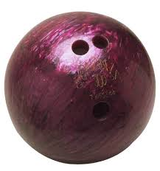
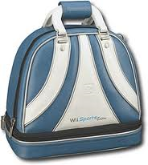
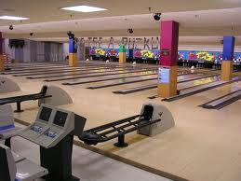
Bowling Equipment
Bowling Ball
Bowling Shoes
Bowling Bag (optional)
Bowling Alley

Slide 4
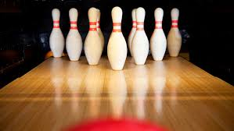
Goals To Bowling
There are 10 pins set in a triangle shape at one end of an alley.

Slide 5
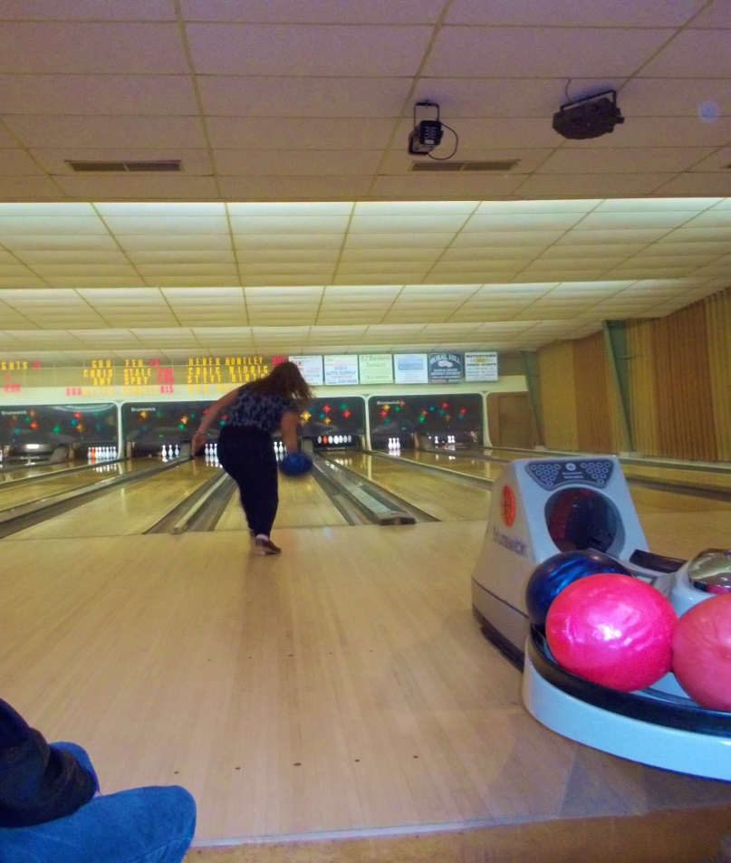
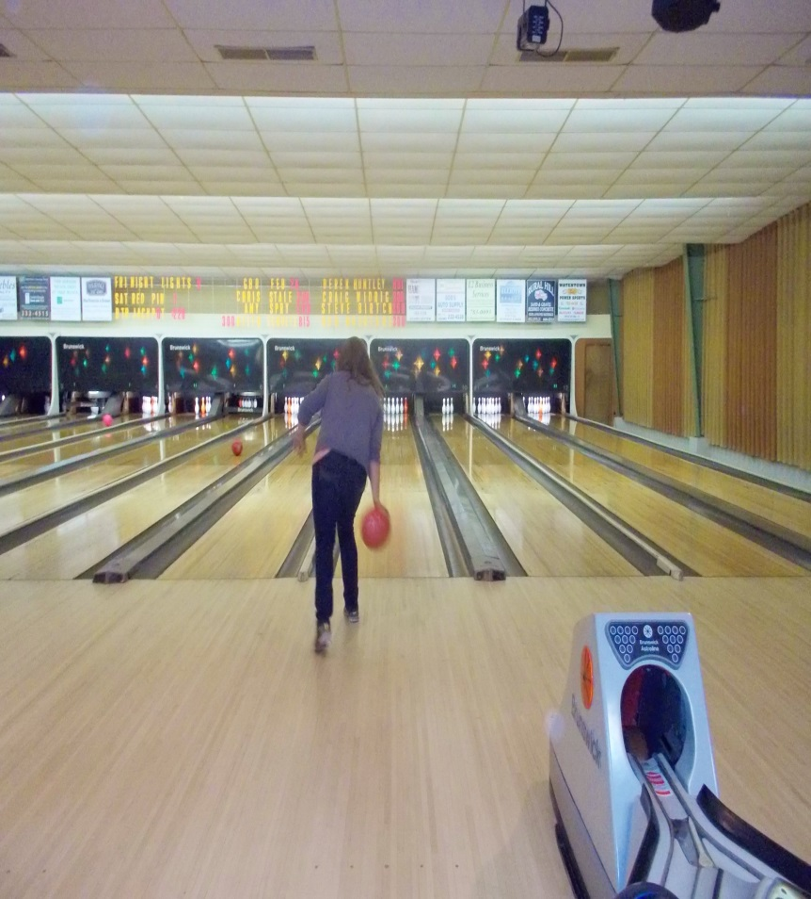
Goals To Bowling
Players roll a ball from the opposite end of the alley.

Slide 6
Goals To Bowling
The point is to knock down as many pins as possible.
Players receive two chances to knock down the pins in a row, this is called a FRAME.
There are ten frames per game.
If a player knocks down all the pins on their first chance, they don’t go again. This is called a STRIKE.
If a player knocks down all the pins on their second chance, this is called a SPARE.

Slide 7
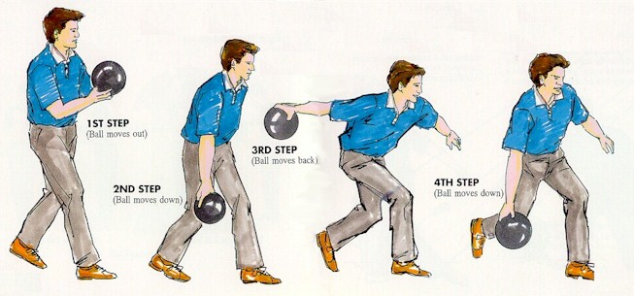
Bowling Technique

Slide 8
Scoring in Bowling
How to Score a Strike
A strike is worth 10, plus the value of your next two rolls.
At minimum, your score for a frame in which you throw a strike will be 10 (10+0+0). At best, your next two shots will be strikes, and the frame will be worth 30 (10+10+10).
Say you throw a strike in the first frame. Technically, you don't have a score yet. You need to throw two more balls to figure out your total score for the frame. In the second frame, you throw a 6 on your first ball and a 2 on your second ball. Your score for the first frame will be 18 (10+6+2).

Slide 9
Scoring in Bowling
How to Score a Spare
A spare is worth 10, plus the value of your next roll.
Say you throw a spare in your first frame. Then, in your first ball of the second frame, you throw a 7. Your score for the first frame will be 17 (10+7).
The maximum score for a frame in which you get a spare is 20 (a spare followed by a strike), and the minimum is 10 (a spare followed by a gutter ball).

Slide 10
Scoring in Bowling
How to Score an Open Frame
If you don't get a strike or a spare in a frame, your score is the total number of pins you knock down. If you knock down five pins on your first ball and two on your second, your score for that frame is 7.
Putting Everything Together
Many people understand the basics but get confused when trying to add everything up. Your total score is nothing more than the sum of each individual frame. If you treat each frame individually, it's much easier to comprehend the scoring system.

Slide 11
How to get involved
You can be as involved in bowling as you want.
You can simply go to your local bowling when you wish to bowl.
You can join a bowling league if you feel more dedicated. There are various leagues that play at different times, and skill levels.

Slide 12
Local Bowling Alleys
South Jefferson Lanes
10849 US Route 11, Adams, NY 13605
(315) 232-4541
Pla-Mor Lanes
577 State St, Watertown, NY 13601
(315) 786-3356
Seaway Lanes
22116 US Route 11, Watertown, NY 13601
(315) 788-4050

