Slide 1


Football
By:
Nate Leviker

Slide 2
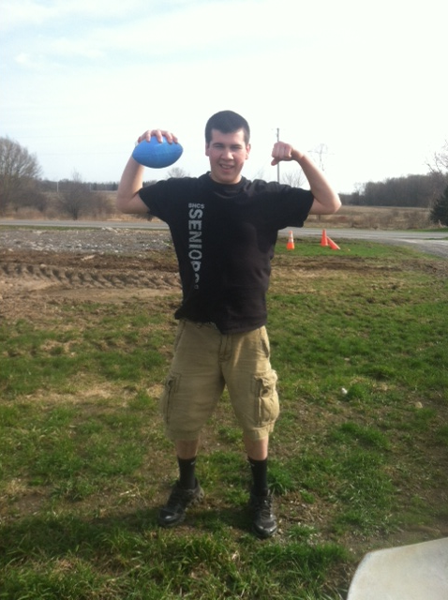

Slide 3
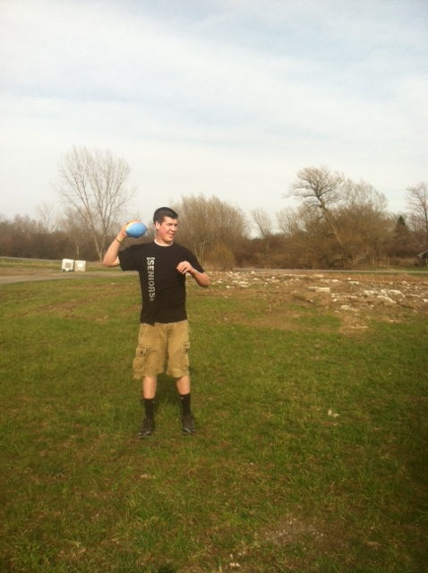

Slide 4


Slide 5
Hike Hike

Slide 6
Rules and Regulations
Game play in Football consists of a series of downs, individual plays of short duration, outside of which the ball is dead or not in play. These can be plays from scrimmage—passes, runs, punts, or field goal attempts—or free kicks such as kickoffs. Substitutions can be made between downs, which allows for a great deal of specialization as coaches choose the players best suited for each particular situation. During a play, each team should have no more than 11 players on the field, and each of them has specific tasks assigned for that specific play.

Slide 9
How to pursue and get involved with Football??
Ask your gym teacher to play more football in gym class
Get your friends and family to play in the park or on the soccer field
You can play on a pick up team at the YMCA

Slide 10
The End

