Slide 1
Running…a life long activity
By Jessie Miller

Slide 2
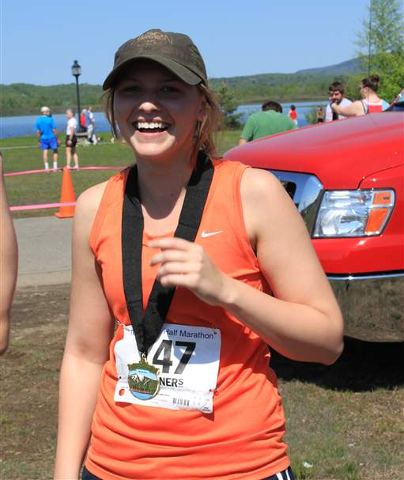
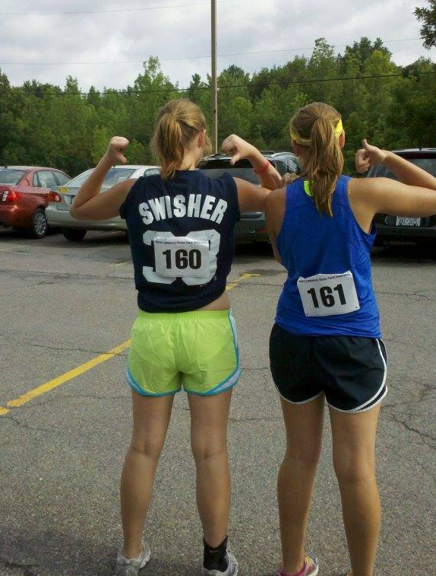
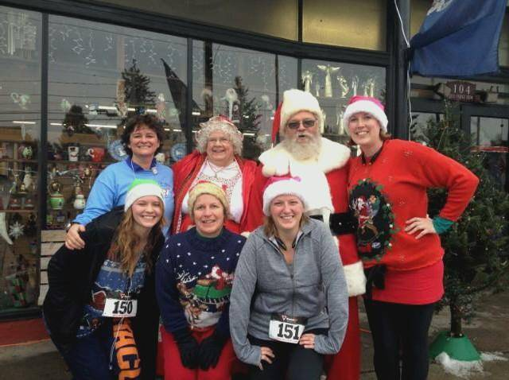
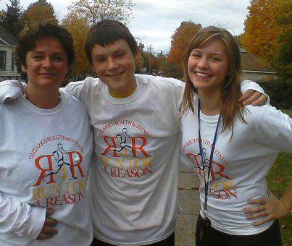
I’ve been using running as a workout for a year now. I’ve run six 5ks, two 5-miles, and one half-marathon since then. That's a total of 9 races.
It’s a lot of fun running those races and even more when you get friends involved.

Slide 3
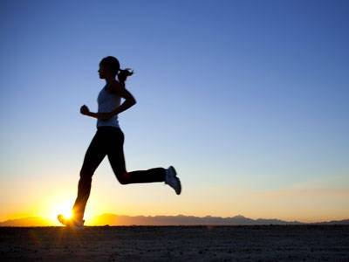
There are many benefits to running but the best is the effects on the heart. Running is a type of cardio workout so it improves the heart which lowers blood pressure, and reduces the risk of heart attack.
Why fit running into you life?
Just go for a jog down the road or on a treadmill for a bit. 30 minutes of your day isn't asking much. That's only a little over 2% of your day. Start off slow don’t push yourself and you will be surprised with what you can accomplish if you stick with it.

Slide 4
5

Slide 5
How to add running into your life.
It’s recommended one participate in a cardio activity 30-60 minutes five times a week. I run 3-5 miles five times a week. I run at a pace of 9-11 minute mile.

Slide 6
How to add running into your life.
If you already are working out chances are if your using a strength workout they recommend cardio so use running as your cardio.
It doesn’t ask for any equipment. You don’t even need shoes but I really recommend a pair, a good pair can make a real difference.

Slide 9
How to get involved.
Most communities have a running team that meets up once a week to just go run for an hour.
If there isn’t one in your community you can start one.
Fundraisers hold 5ks and 10ks throughout the entire year, more so in the spring-fall seasons.
http://www.syracusechargers.org/ and http://www.active.com/ are great websites for finding races in your area.

