Slide 1
Rebecca Lillie Senior Project
P.E
9th period

Slide 2
Yoga

Slide 3
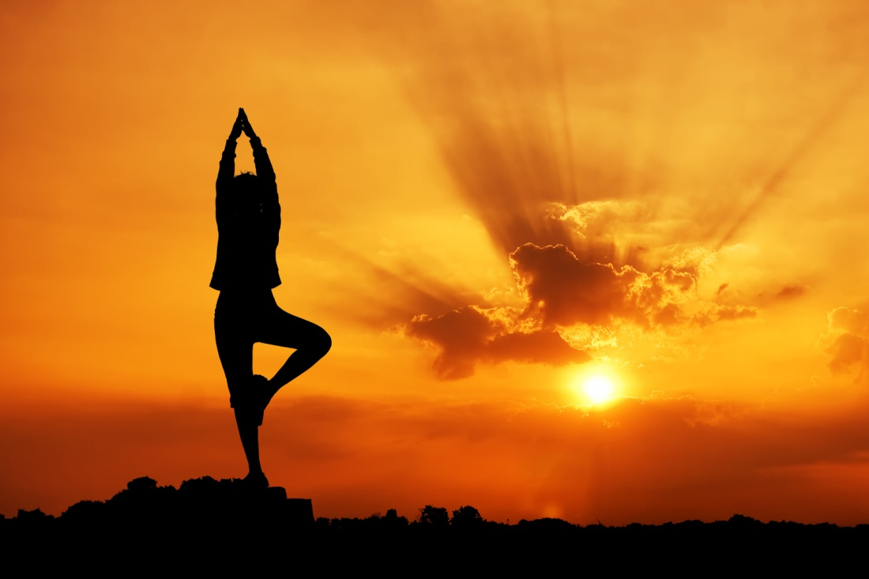
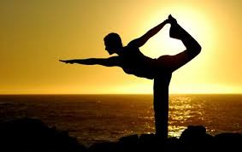
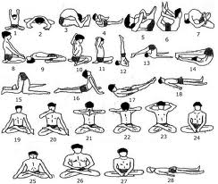

Slide 4
Rules

Slide 5
1) Should be practiced on an empty stomach: in case you ate, wait for at least 3 hours before practicing. 2) relax for 10 seconds at least after each yoga exercise. Do not exert! 3) avoid excessive intake of tea or coffee when you are doing yoga. 4) wear loose and comfortable clothes. 5) begin with easy poses, thereafter you can advance to tough ones. 6) do not practice yoga on bare ground, use thin yoga mat or thick bed sheet. 7) before you start, clean your bowels and bladder: clean your nostrils and throat. 8) women should not practice during menstruation. 9) food should be taken after ½ hours after. 10) its normal to exhale while bending forward and inhale while moving backwards. 11) most appropriate time is in the morning. Time when the mind is calm, composed, and fresh.

Slide 6
Regulations

Slide 7
1) Eligibility 2) Proof of age 3) Prohibition 4) Entry 5) Attire 6)asanas 7) rules 8) criteria

Slide 8
How to get involved?

Slide 9
1)Go to a couple websites and understand the rules and regulations. 2)Then out where the classes will be held or once you get eh hang of it do it yourself or watch a couple videos on yoga. 3)Go to a couple classes and try it. 4)Understand the different types of yoga and figure out which one you like and do it.

Slide 10
How to pursue yoga?

Slide 11
1) Doesn’t matter the age, height, race, gender, sexuality, your body size. Anyone can do yoga. 2) Once you start yoga you can do it right up until you die, unless your told otherwise. 3) Easily to get started and easily to do and easily to finish when you get older.

